Slide 1
Year 3 –Spring Forum 2020
Class teacher – Miss Campbell
Teaching assistant – Miss Patterson

Slide 2
Year 3
We work hard to ensure all children in the class can reach their full potential.
Children are encouraged to become independent and motivated learners.
We have high expectations of all the children.
Presentation plays a key role throughout all curriculum subjects.

Slide 3
The Power of Yet…..

Slide 4
Maths
Number: Multiplication and division
Measurement: Money
Statistics
Measurement: Length and Perimeter
Number: Fractions
CLIC maths sessions
Times Tables Rock stars

Slide 5
Reading and Spelling
ERIC - 4 guided reading sessions per week where children work in groups with adult support.
Focussing on reading fluency, inference, prediction, retrieval and summarising of the text.
Children take their guided reading books home and are set pages to read at home with family.
Introduced new reading diaries, to record when you have heard your child read.
Weekly spelling sent home each Friday and tested the following Friday. Please support your children by encouraging them to practice their spellings regularly.
Set 2 of Non-negotiable words to learn and practice in school.
Additional spelling practice sheets may be sent home, these will be in the form of worksheets.

Slide 6
Literacy
Hetty’s Unicorn
Digging Deeper
Mystery and Suspense
Spelling
Punctuation
Grammar
Myth
Non-chronological report writing

Slide 7
History & Geography
History Detectives – Local History
Victorian Berwick
We will be history detectives finding out what life was like over 100 years ago around the times of the Victorian period and into the Edwardian Period.
Geography – What it’s like in Berwick?
Working on Field skills, Map making, surveying land use and using a key/legend.

Slide 8
Then move onto……..
British History - Anglo Saxons.
We will learn about the invasions of the Scots and Anglo-Saxons in the 5th century.
Children will find out where the invading troops came from and where in Britain they managed to settle and then they will go on to investigate how life in Britain changed as a result.
The children will have the opportunity to learn how the Anglo-Saxons influenced the English language, with an emphasis on the origins of some English place names.
In addition to this they will also learn what life was like in a typical Anglo-Saxon village, what jobs people did, what the houses were like and local criminology,

Slide 9
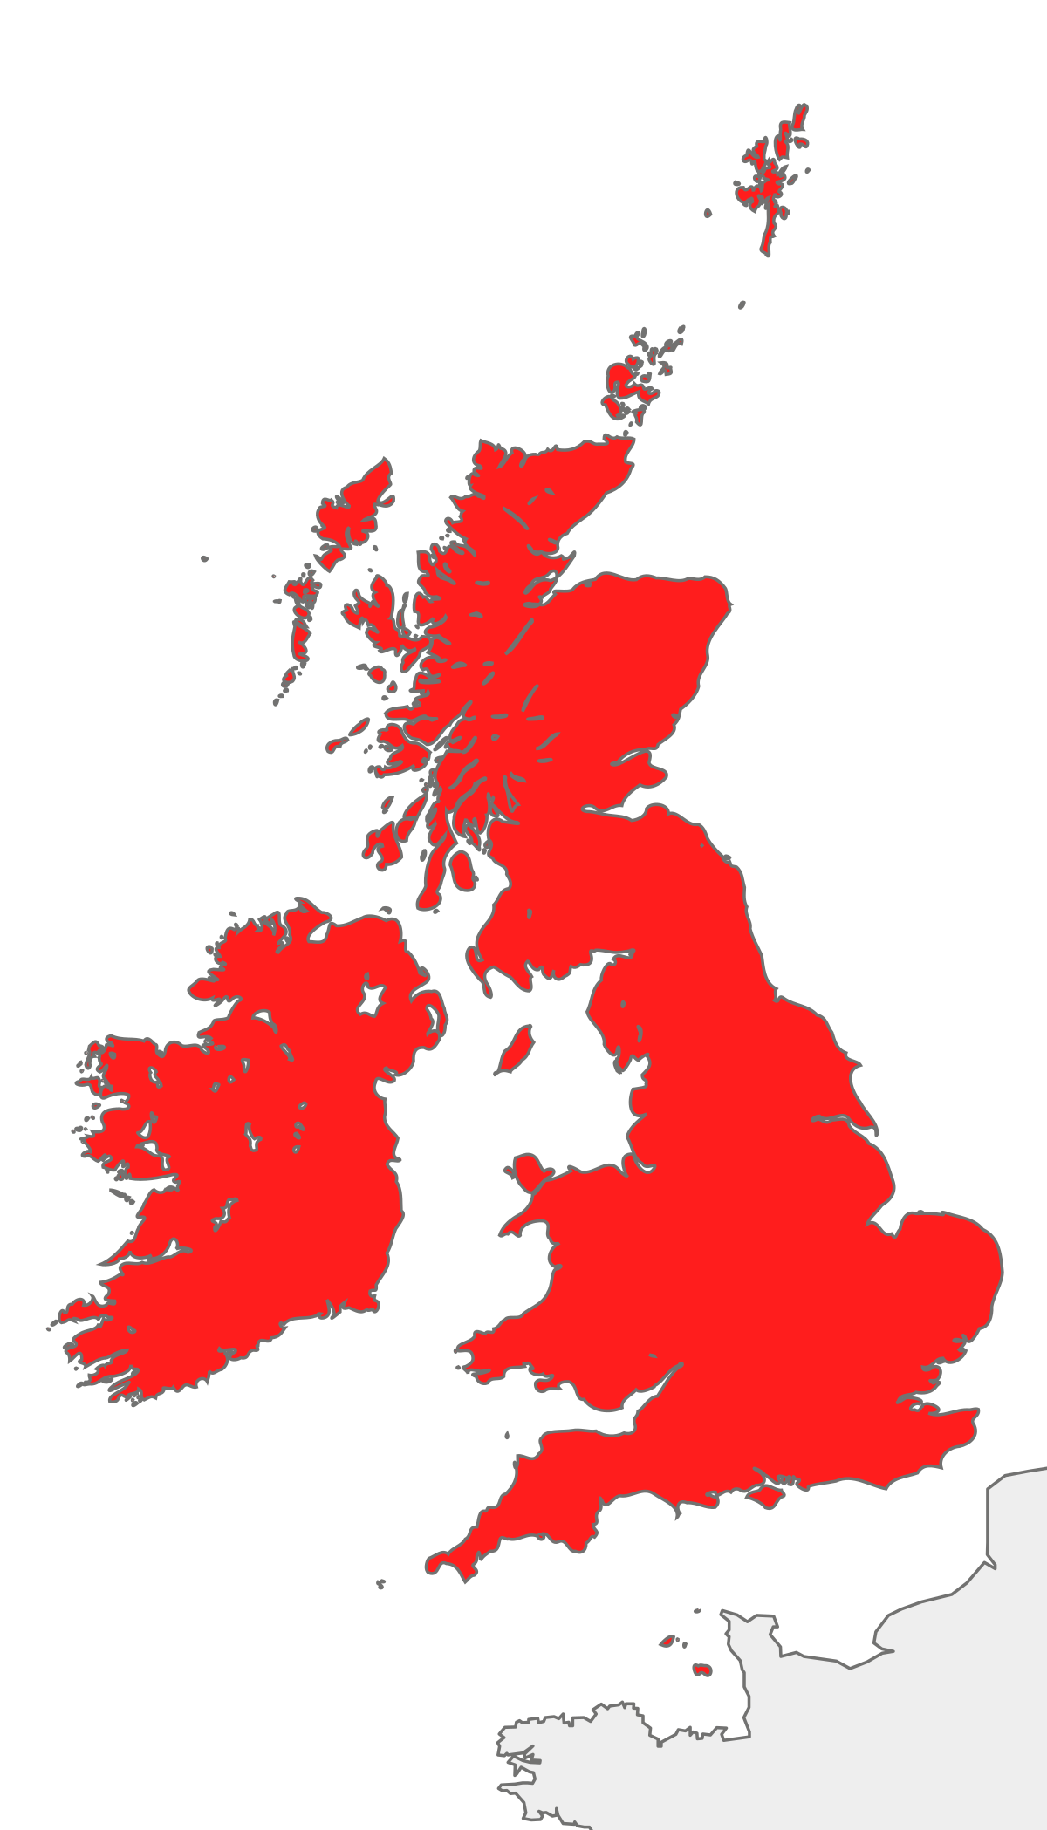
Linked to……………
Geography - The British Isles
Location Knowledge
Children will be able to name and locate counties and cities of the United Kingdom, geographical regions and their identifying human and physical characteristics.
Name and locate key topographical features [physical features] (including rivers, mountains & valleys).
Land-use patterns[farming and changing population within the UK], understand how some of these aspects have changed over time.
Climate of Britain.

Slide 10
Science
Light
Forces and Magnets

Slide 11
Religious Education
Christianity
Judaism
Christianity: Communities and how it feels to belong to a community. Begin to explore rites of passage / ceremonies that mark transitions in life.
Explore the events of Holy week and the significance of Easter to Christians.
Judaism: Explore the festival of Passover it significance to Jews.
Festivals & Beliefs

Slide 12
After school clubs .Badminton .Gladiators .Gymnastics
PE
Apparatus
Dance
Racket skills
Tag rugby

Slide 13
Computer Studies
Algorithms – https://www.bbc.co.uk/bitesize/clips/z28qmp3
Using their knowledge of programming, the children will work out the algorithms for various instructions and work together to decide how to code specific commands.
E-Safety – Raising awareness of safe internet use.

Slide 14
Music – Miss Huntly Learning about rhythm, beat, tempo, timbre, reading musical notes. Writing and performing songs.
Art -Textiles
Shape and stitch materials
Create weavings
Design & Technology
Photo Frames/Packaging
Children will design, make, and evaluate their product in conjunction to applying technical knowledge.

Slide 15
RSHE (PSHE) Relationships, sex and Health Education Thrive Sessions (Mrs Pick -Trained Thrive Practitioner) Support children with their emotional and social development using practical strategies and techniques.
P4C
MFL – French
All about me
Oh la la!

Slide 16
Housekeeping
Learning logs - due in on a Thursday.
Reading - Monday to Thursday & weekend
Spellings – Tested and new spellings given out on a Friday.
PE – Monday & Thursday (full kit must be left in school.
Clubs – kept informed via parent mail (£1 per club 3:15-4:15)
Field days will resume as soon as weather permits.
Upcoming Events – January 2020
Granary Gallery Visit (Wilhemina Barns-Graham)
Dance workshop with Cheryl Stewart

Slide 17
Any Questions ?

