Slide 1


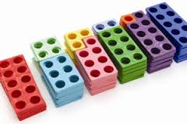
Maths Workshop
Rec, Year 1 and Year 2
Mrs Poole
Maths Co-ordinator

Slide 2
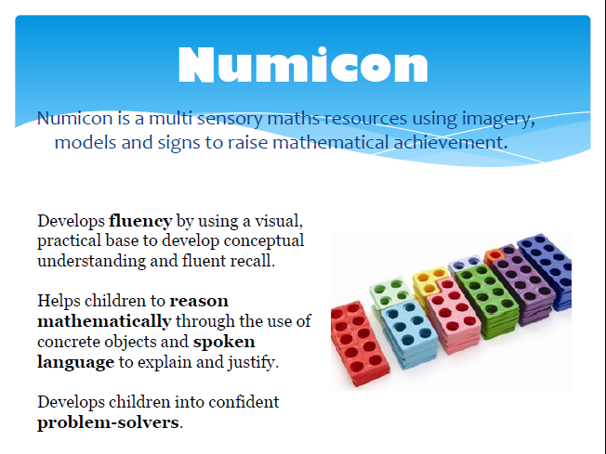

Slide 3
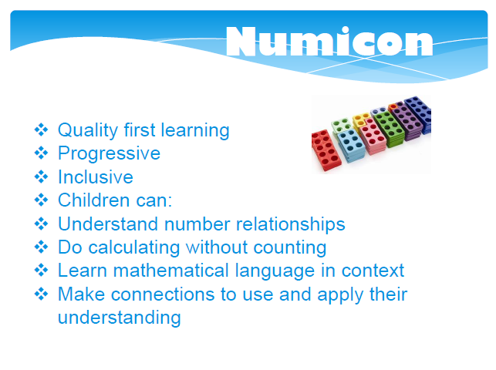

Slide 4
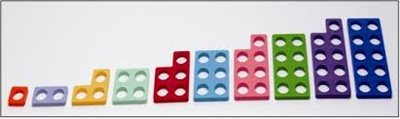
Numicon
Can you put the Numicon shapes in order from 1 to 10?
Why do some pieces have ‘sticking out bits’?
Notes:
Play following games:
Feely bag; feel inside the bag can you find the pink shape?
Describe shape – hold up when you have it!
Feely bag; what shape am I holding?
Find the number which you add to 6 to make 10?
Child have a go!
Play missing number with your child.
Choose a numicon shape. Lets move, find someone that added together would make an even number, what do you notice? Find someone that added together would make an odd number. What do you notice. Look for patterns.
Can you make number bonds to 10 using the Numicon?

Slide 5
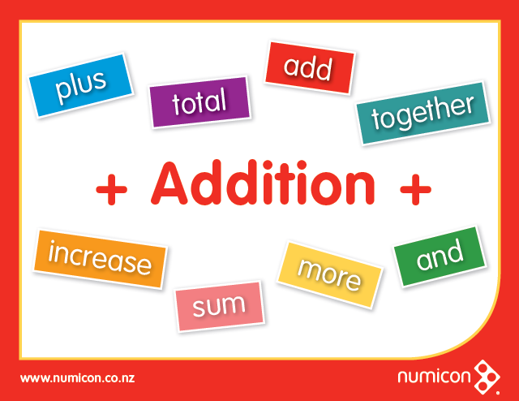

Slide 6
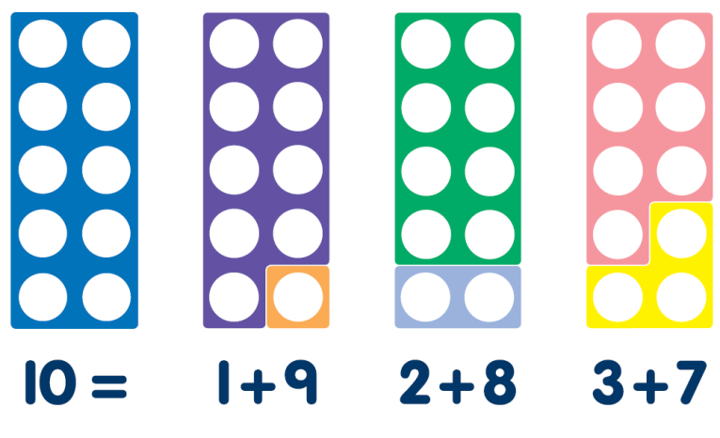
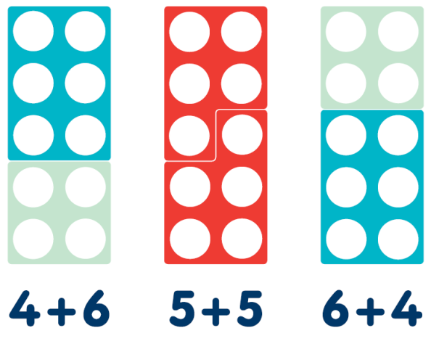
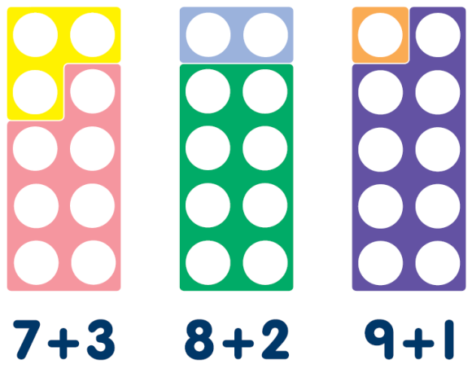
Number Bonds to 10

Slide 7
Number Bonds to 20
Make a teen number using a ten and a single digit number. How many more to get to Twenty?
What is ten more?
What is ten less?

Slide 8
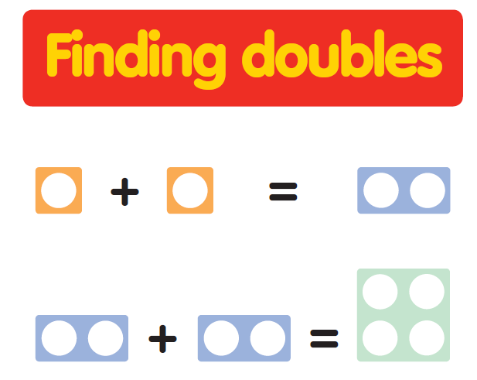

Slide 9
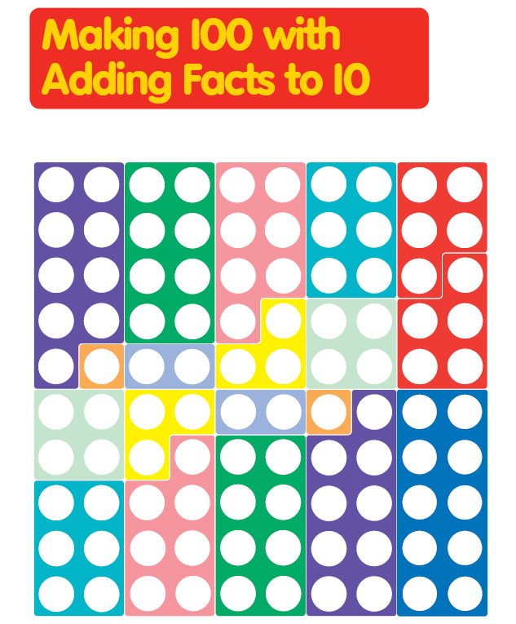

Slide 10
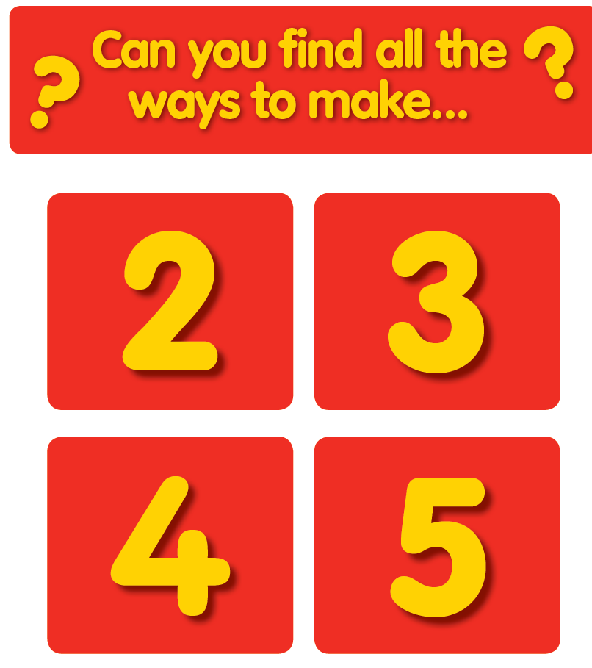
Notes:
0 + 2 = 2
1 + 1 = 2
0 = 3 = 3
1 + 2 = 3
2 + 1 = 3

Slide 11
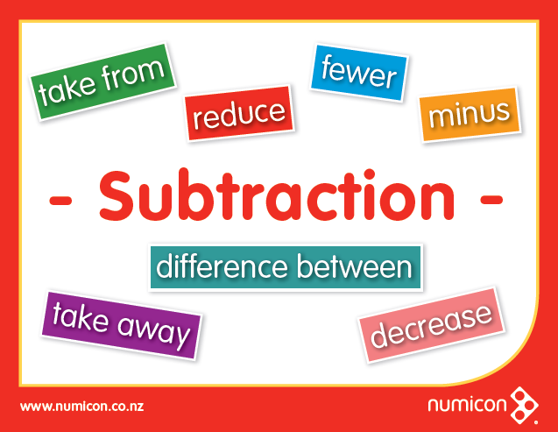

Slide 12
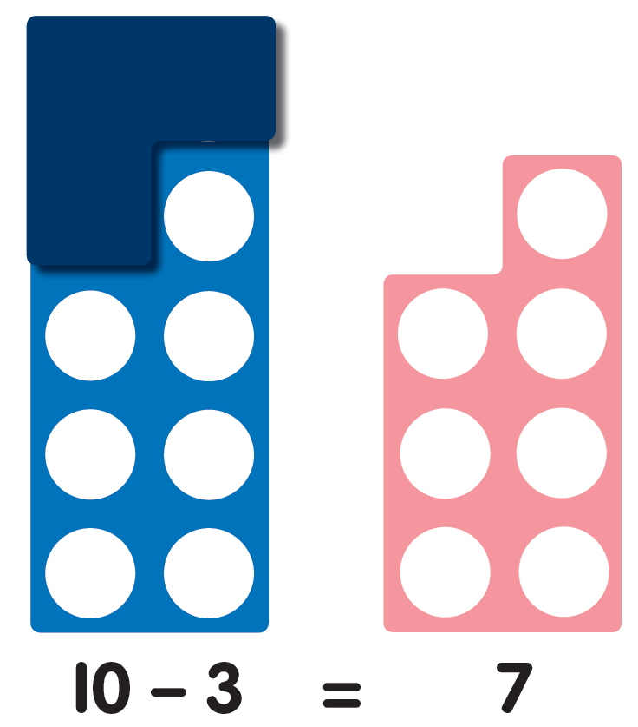

Slide 13
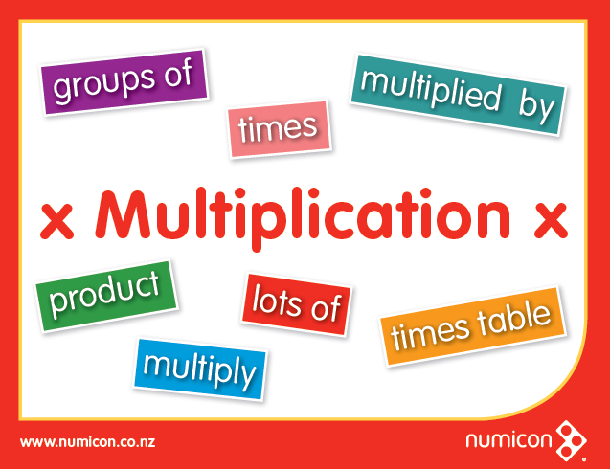

Slide 14





Multiplication
4 x 3 = 12
5 x 2 = 10
2 x 5 = 10
6 x 4 = 24

Slide 15

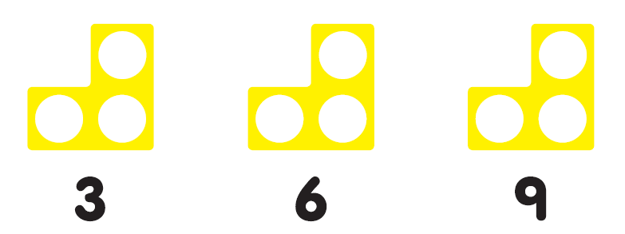
Investigate times tables 3, 5 and 7 ask child;
What pattern do you notice?
Do you think this pattern will continue? Why?
Can you prove it?
The same could be done for times tables with even numbers.
Creating links all the time help children to recall the information.

Slide 16
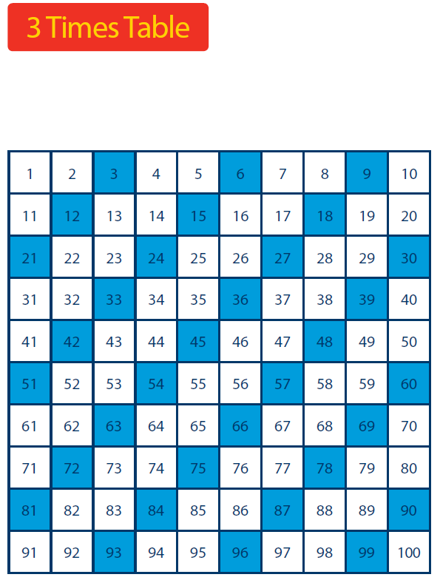
Can you spot patterns on a 100 square?

Slide 17
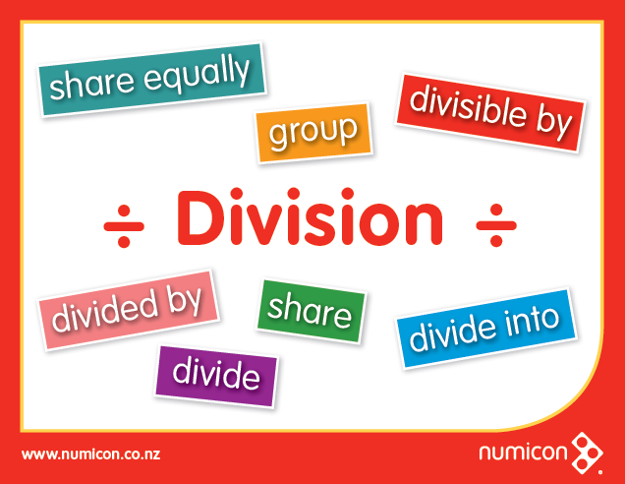

Slide 18
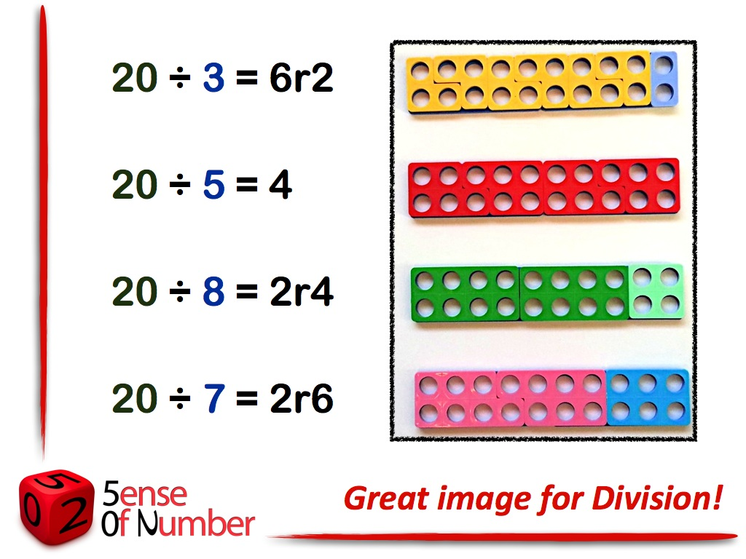

Slide 19
Parents Resources
www.numicon.co.nz
There are lots of free resources online using the above website, including resources to print, activities etc.
If you feel you would like to purchase Numicon for your child at home we can offer two different resources:
Box 1-10 shapes - £ 4.50 + VAT
Maths Homework Bag - £13.50 + VAT

Slide 20
Maths Homework Bag

